Slide 1
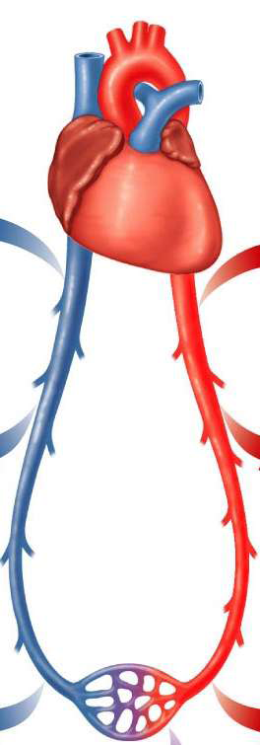
L9 Physics of Blood Flow in Small Arteries
Medical physics- first year
By: Dr.Ghania Salim Al-Thaher
Physiology Department
College of Medicine
University of Basrah

Slide 2
Learning Objectives
By the end of this section, you will be able to:
Pressure across the blood vessel wall
Type of fluid &Laminar and Turbulent Flow
Blood flow
Poiseuille’s Equation
The resistance in the vascular system
Pressure and Blood Flow

Slide 3
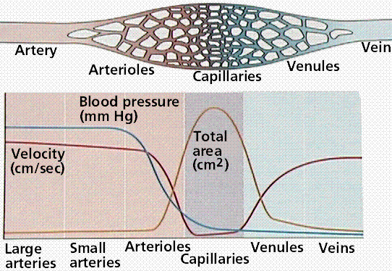
Pressure across the blood vessel wall
The greatest pressure drop in the cardiovascular system occurs in the region of the arterioles and capillaries.
The capillaries have very thin walls (~1 μm) that permit easy diffusion of O2 and CO2.

Slide 4
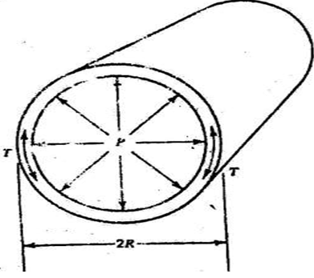
Why the capillaries do not burst?
The law of Laplace, the tension in the wall of a tube is related to the radius of the tube and the pressure inside the tube.
Consider along tube of radius R carrying blood at pressure P. We calculate the tension T in the wall.
T = RP

Slide 5
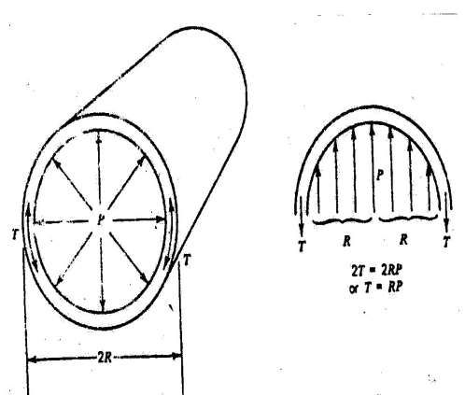
We can divide the tube in half as shown in figure.
The force per unit length pushing upward is:
2RP
There is a tension force T per unit length at each edge that holds the top half of the tube to bottom half.
2T
Since the wall is in equilibrium, the force pushing the two halves a part is equal to the tension forces holding them to gather or 2T =2RP
or T =RP Laplace equation

Slide 6
For example, the tension in the wall of the aorta is about 156,000 dynes/cm while the tension in a capillary wall is only about 24 dynes/cm.
For comparison, a single layer of toilet tissue can withstand a tension of about 50,000 dynes/cm before tearing.
This tension is about 3000 times greater than that the capillary has to withstand.

Slide 7
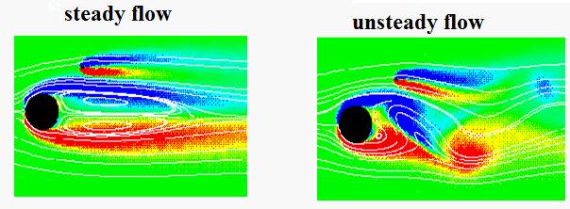
Physics of Blood Flow in Small Arteries
The ideal fluid (Gas and Liquid): | The real fluid :
1.It is incompressible (the density of the fluid is constant); | 1. It is compressible
2.Nonviscous ( the fluid has no internal friction | 2. Viscous
3. Steady flow ( the velocity of the fluid at each point is constant in time). | 3. Velocity is changed

Slide 8
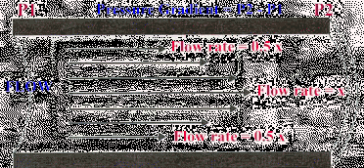
Laminar and Turbulent Flow
Laminar Flow: "Streamline flow of a fluid in which the fluid moves in layers without fluctuations or turbulence so that successive particles passing the same point have the same velocity .

Slide 9
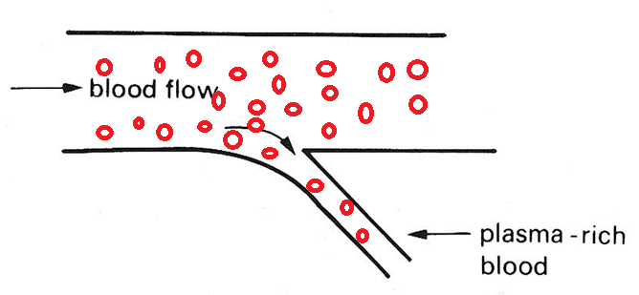
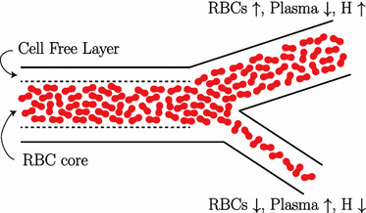
The red blood cells in an artery are not distributed uniformly; there are more in the center than the edges
This produces two effects:
1-When blood enters a small vessel from the side of main vessel the percentage of red blood cell in that blood (the hematocrit) will be slightly less than in the blood in the main vessel because of the (skimming effect.) or (plasma skimming)

Slide 10
2-The plasma along the vessel walls is moving more slowly than the red blood cells, the blood in the extremities has a greater percentage of red blood cells than when it left the heart .
This causes an increase in the hematocrit in the hands and feet of approximately of 10% over the hematocrit of the whole blood.

Slide 11
Turbulent flow
Turbulent flow is characterized by the irregular movement of particles (chaotic) of the fluid.
This type of flow makes an audible noise, which can be heard by a stethoscope. Obviously, flow that is turbulent causes much more resistance in the blood vessel than that laminar flow.

Slide 12
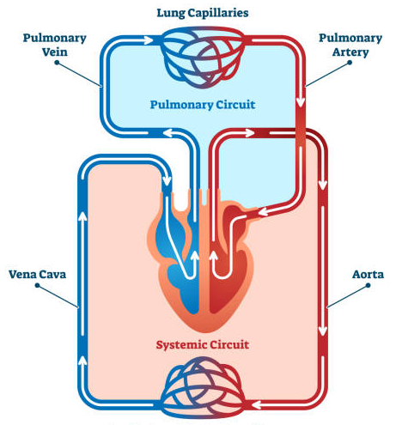
Blood flow refers to the movement of blood through the vessels from arteries to the capillaries and then into the veins. Moreover, usually expressed in terms of volume of blood per unit of time.

Slide 13
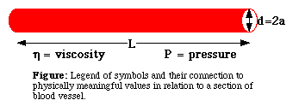
Poiseuille’s Equation
The flow rate due to Poiseuilles law:
$$Q=\frac{πr^{4}ΔP}{8ηL}$$
The factors affect the blood flows in the vessel and its units of measurement:
Pressure difference (ΔP):
/25

Slide 14
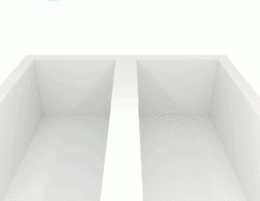
2. Viscosity of fluid (η). The flow of fluid varies inversely with the viscosity of fluid, i.e. greater the viscosity, lesser the flow and vice versa.
The viscosity of blood is typically 3x ${10}^{−4}$ to 4x${10}^{−4}$pas.
P (Poise) or Pa·s or kg·m−1·s−1 are the units For the formula, convert P (Poise) to (Pa. s) by dividing the value by 10.
/25

Slide 15
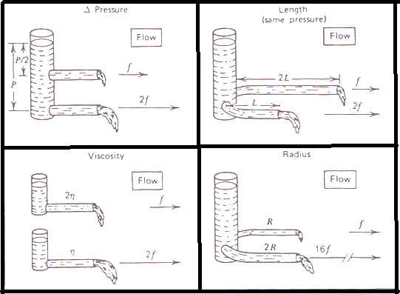
3. Radius (a),: if the radius is doubled the flow rate increases by 2⁴ or factor 16.
4. Length of the vessel (L). The flow is inversely proportional to the length of the vessel.
/25

Slide 16
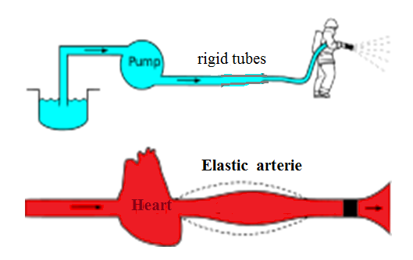
Poiseuille's law applied to rigid tubes of constant radius. Blood flow in the circulatory system dos not obey the law exactly because of major arteries have elastic walls and expand slightly at each heart beat.
/25

Slide 17
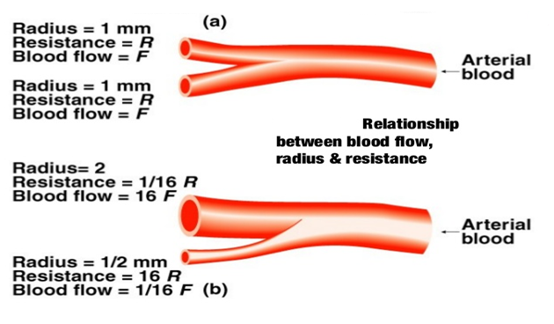
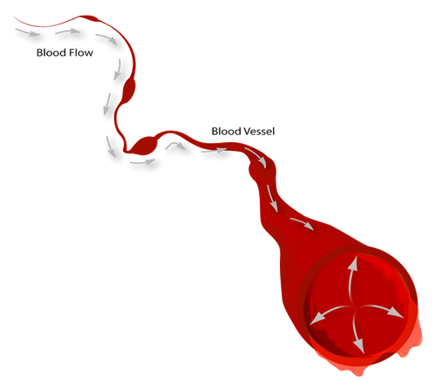
The resistance in the vascular system
The higher the pressure exerted by the heart, the faster blood will flow.
The higher the resistance, the slower the flow rate.
Q$α 1/R$
Q$α ∆P$
/25

Slide 18
Resistance (R). According to mathematical calculation in principles of physics, resistance (R) is represented by
$$R=\frac{8ηL }{πr^{4}}$$
By replacing $\frac{8ηL }{πr^{4}}$ with R in the Poiseuille’s law, it becomes:
Q = ∆P / R
Q = Flow (Rate)
∆ P = pressure gradient
R = resistance
/25

Slide 19
There are only three variables: viscosity, vessel length, and radius, since 8 and π are both constants.
Two of these variables, viscosity and vessel length, will change slowly in the body.
Only one of these factors, the radius, can changed rapidly by vasoconstriction and vasodilation, thus dramatically affecting resistance and flow
Small changes in the radius will greatly affect flow, since it raised to the fourth power in the equation.

Slide 20
Ohm law
Thus, the Poiseuille’s law can be considered analogous to the Ohm’s law of current in which:
Blood flow rate: means the quantity (volume) of blood passes a given point in the circulation in a given period of time (ml/sec), (L/min)
Q=V/t
V:volume t : time
Electrical current: means the quantity of charge passed through a material in period of time
I = e/t
I : current
e: electrical charge
I=∆V/r ohm's law
∆V: electrical potential difference
r: ohm's resistance
/25

Slide 21
Q =∆P/R I = ∆V/r
Q I
∆P ∆V
R r
From Poiseuille's Equation:
$Q=\frac{πr^{4}ΔP}{8ηL}$ = $ΔP/R$
R =$8ηL/ πr^{4}$
measured in ohm
/25

Slide 22
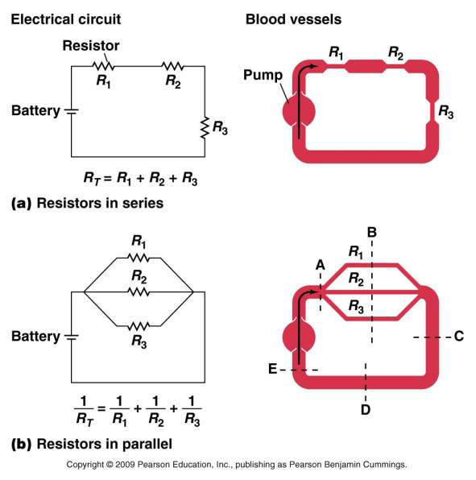
Series :
𝑹_{𝑻} = 𝑹_{𝟏} + 𝑹_{𝟐} + 𝑹_{𝟑}
Parallel :
𝑹_{𝑻}= 1/ 𝑹₁ + 1/ 𝑹_{𝟐}+1/𝑹_{𝟑}
Circulatory systems have both series and parallel arrangements of blood vessels.
/25

Slide 23
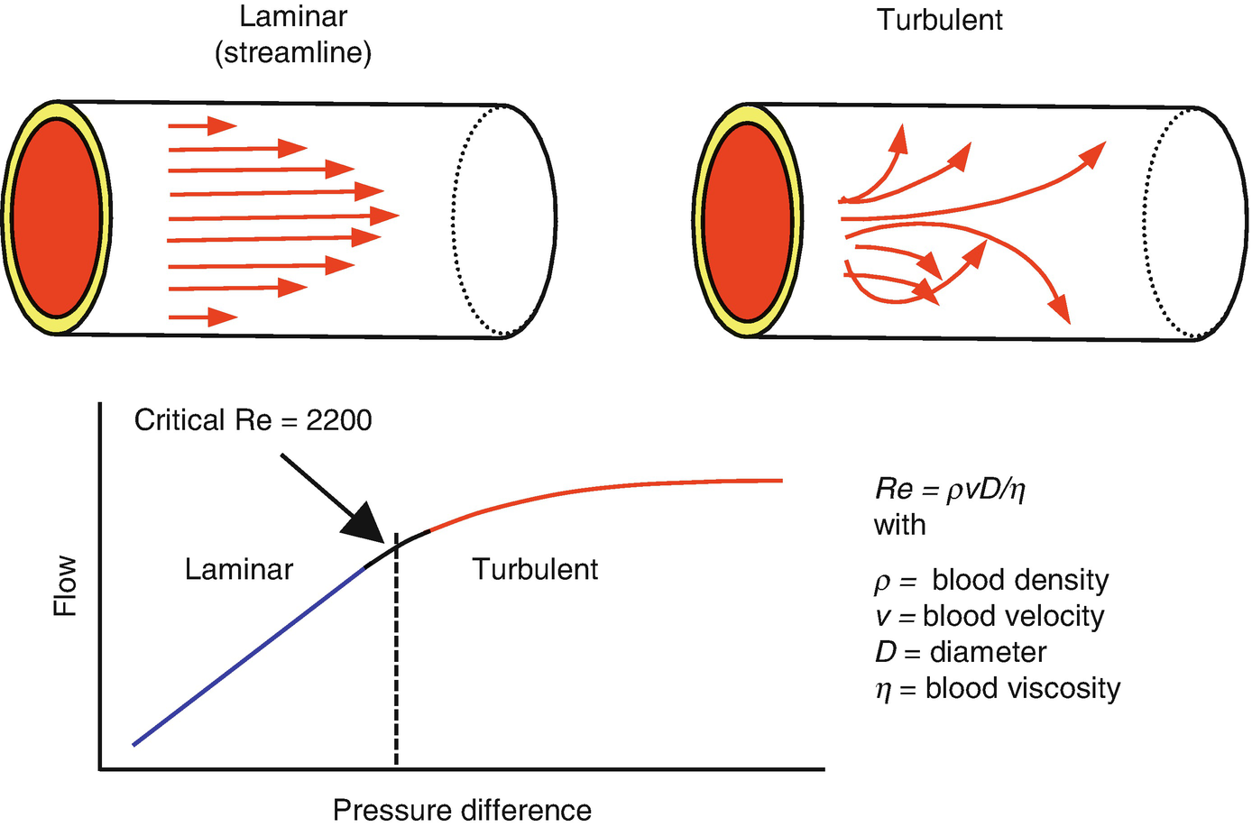
Pressure and Blood Flow
If the velocity of a fluid flowing in a tube increased by reducing the radius of the tube it will reach a critical velocity V_{c} when laminar flow changes

Slide 24
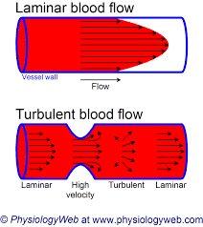
Critical velocity
Critical velocity is the velocity of a liquid flow up to which its flow is streamlined and after which its flow becomes turbulent.
The critical velocity depends on
Coefficient of viscosity (η),
Density of the liquid ($ρ$), and
Radius of the tube (r).
/21

Slide 25
Using the methods of dimensions, one can show that :
V_{c} =$\frac{Kη}{ρr}$
$ρ :$ density r:radius $η:$viscosity K : Reynolds's number$≈1000$for many fluids (blood)
The critical velocity will be lower if there are restrictions or obstructions in the tube .
Reynolds Number (K) number is a pure number that determines the nature of flow through a pipe
The Reynolds number is the ratio of inertial forces to viscous forces.
then K= ( V_{c} ρr )/η
/21

Slide 26
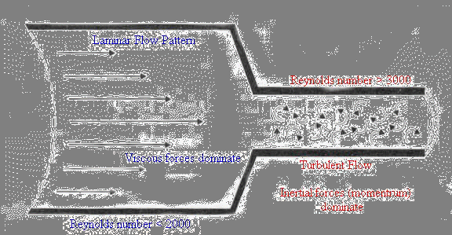
The Reynolds number is used to determine whether a fluid is in laminar or turbulent flow.)
If the value of Reynolds Number
K lies between 0 to 2000, the flow of liquid is streamline or laminar (the layers of liquid glide or slip over one another like sheets or laminar).
If the value of K is greater than 3000, the flow is turbulent.
For values in between, the flow is not steady and changes from one to another.
/21

Slide 27
Example: Find the kinetic energy (KE) of 2gm of blood leaving aorta of radius 1.2cm.
K.E = (Mv²)/2
V_{c} = $\frac{Kη}{ρr}$
V_{c} = $\frac{Kη}{ρr}$= (1000×3.5×10⁻³)/(1.04×10³×1.2×10⁻²)
V_{c} = 0.28 m/s
K.E= (1/2)×(2×10⁻³)×(0.28)²
=8×10⁻⁵ joule

